Slide 1




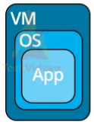


Instalasi Ubuntu Server &
Domain Name System
PDS
Computer Vision
Variable Length Subnet Mask (VLSM)
@ P. Siagian
https://github.com/siagianp
https://www.youtube.com/@AmelOline/videos
https://github.com/siagianp
https://github.com/amelcharolinesgn2/IoT_simulator-mqtt-NodeRed
https://www.youtube.com/@AmelOline/videos
https://github.com/amelcharolinesgn2/IoT_simulator-mqtt-NodeRed
https://github.com/amelcharolinesgn2/Cloud-Infrastructures
https://github.com/amelcharolinesgn2/Cloud-Infrastructures
https://github.com/amelcharolinesgn2/ClouD-Infrastructure-SISKA-2025
https://github.com/amelcharolinesgn2/ClouD-Infrastructure-SISKA-2025
https://github.com/amelcharolinesgn2/Gyroscope-Sensor-Data-Accelerometer
https://github.com/amelcharolinesgn2/Gyroscope-Sensor-Data-Accelerometer

Slide 2

Instalasi Server Ubuntu
Syarat Minimum Hardware Server
Dalam Instalasi Server ubuntu dibutuhkan beberapa syarat minimum Hardware, sebagai berikut
Processor : Intel Pentium 5
Memory : 256 MB
Free Harddisk : 5 GB

Slide 3
Alur Instalasi Ubuntu Server
Masukkan CD Installer
bahasa install
Keyboard Layout
Network Card
Username Password
Partisi
Time Zone
Hostname
DHCP
Pilih cancel jika ingin setting IP
setelah instalasi
Aplikasi
Boot Loader
FINISH

Slide 4
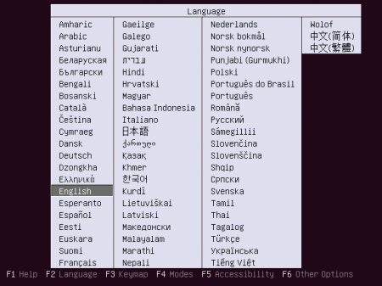
Proses Instalasi
1. Pilih Bahasa Instalasi

Slide 5
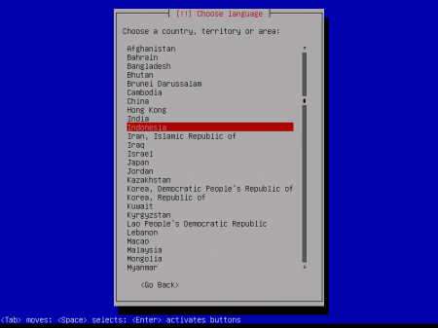
Proses Instalasi
2. Pilih Bahasa Sistem Ubuntu

Slide 6
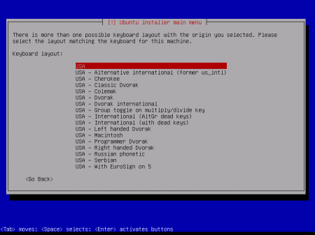
Proses Instalasi
3. Pilih Layout Keyboard

Slide 7
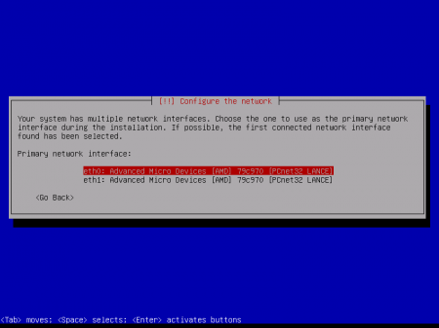
Proses Instalasi
4. Konfigurasi Primary Kartu Jaringan

Slide 8
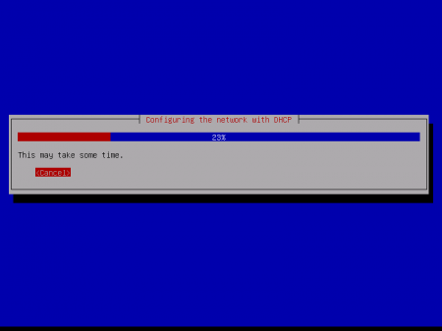
Proses Instalasi
5. Setting DHCP
( jika belum terkoneksi dengan jaringan, maka tekan tombol cancel)

Slide 9
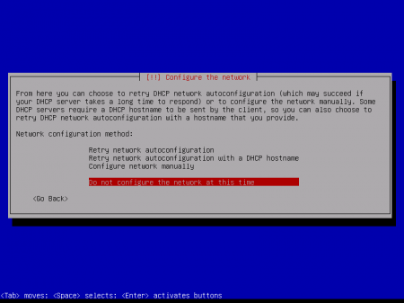
Proses Instalasi
6. Setting DHCP - lanjutan
( jika ingin seting network setelah selesai instalasi, pilih Do not configure the network at this time)

Slide 10
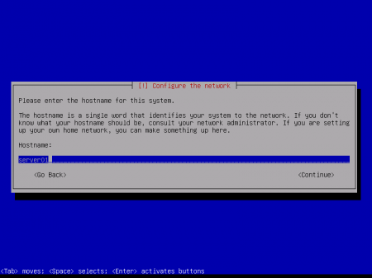
Proses Instalasi
7. Setting Hostname Server

Slide 11
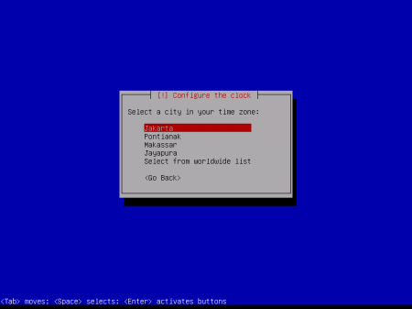
Proses Instalasi
8. Pilih Zona Waktu

Slide 12
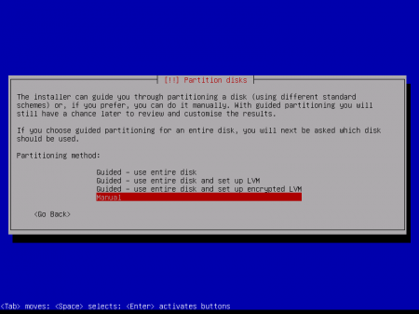
Proses Instalasi
9. Setting Partisi Hardisk

Slide 13
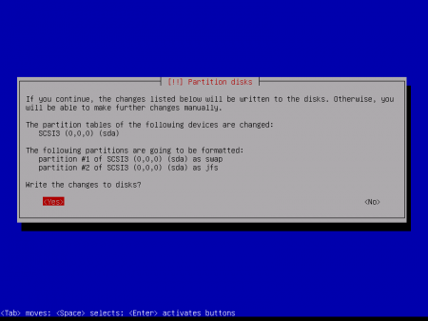
Proses Instalasi
10. Setting Partisi Hardisk- lanjutan

Slide 14
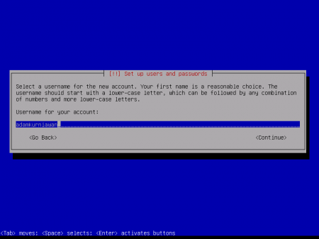
Proses Instalasi
11. Setting Username dan Password

Slide 15
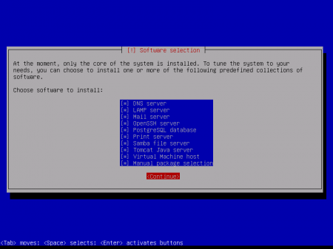
Proses Instalasi
12. Pilih Aplikasi Server

Slide 16
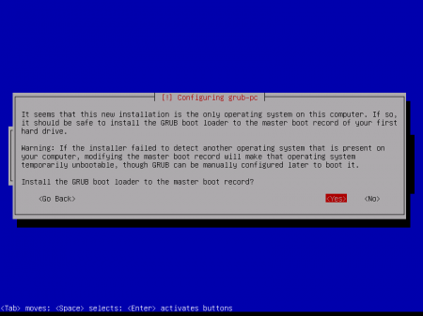
Proses Instalasi
13. Instalasi Boot Loader

Slide 17
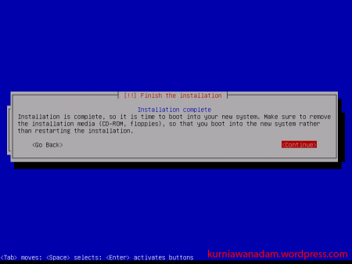
Proses Instalasi
14. Instalasi Selesai

Slide 18
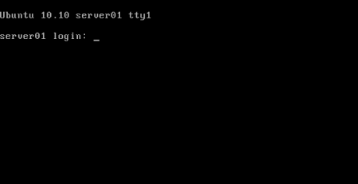
Proses Instalasi
15. Tampilan Halaman Login

Slide 19
Instalasi Domain Name Server (DNS)

Slide 20
Alur Instalasi DNS
Install paket Bind9
named.conf.options
named.conf.local
db.domain
Finish

Slide 21
Tahapan Instalasi
Instalasi Paket Bind 9
# apt-get install bind9
Setelah Instalasi selesai akan mengahasilkan file konfigurasi utama sebagai berikut :
/etc/bind/named.conf
/etc/bind/named.conf.options
/etc/bind/named.conf.local

Slide 22
Tahapan Instalasi
Edit file konfigurasi /etc/bind/named.conf.options
[...]
forwarders {
1.2.3.4;
5.6.7.8;
};
[…]
Ket: 1.2.3.4 dan 5.6.7.8 adalah dns isp

Slide 23
Tahapan Instalasi
Edit file konfigurasi named.conf.local
[...]
zone "domain.com" {
type master;
file "/etc/bind/db.domain";
};
[...]

Slide 24
Tahapan Instalasi
Edit file konfigurasi db.domain
$TTL 604800
@ IN SOA ns.domain.com. admin.domain.com. (
1 ; Serial
604800 ; Refresh
86400 ; Retry
2419200 ; Expire
604800 ) ; Negative Cache TTL
;
@ IN NS ns.domain.com.
ns IN A 192.168.1.10
box IN A 192.168.1.10

Slide 25
Tahapan Instalasi
Restart DNS
# /etc/init.d/bind9 restart
Testing DNS
# ping domain.com
# dig domain.com

Slide 26
=====Finish ===

